Slide 1
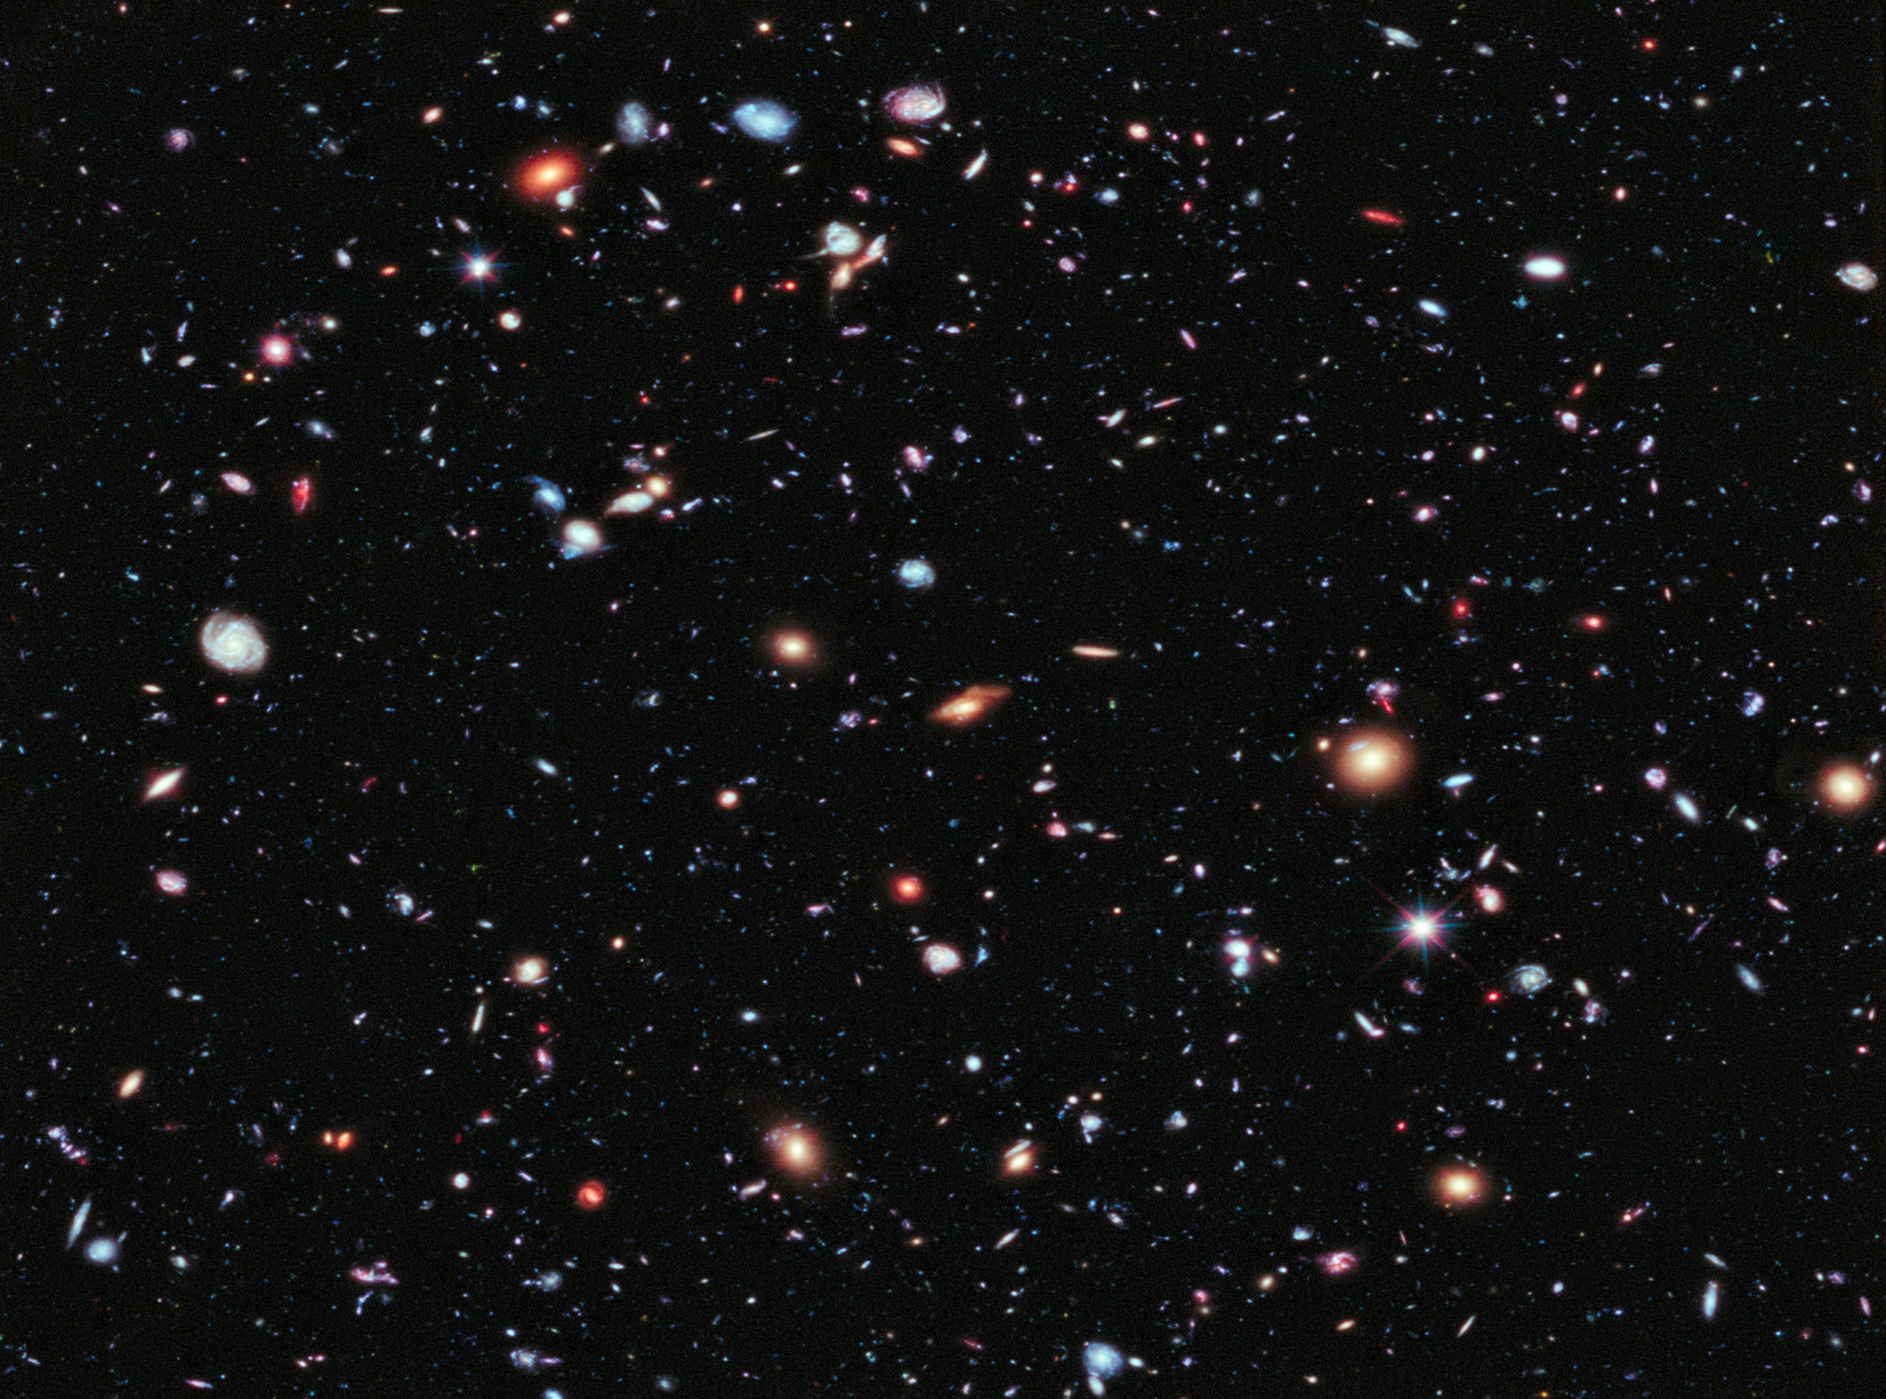

Slide 2
Spectropolarimetry,
Biosignatures,
and the Search for Chirality
Tools for Detecting Life on Exoplanets
W E Martin, J H Hough, E Hesse, J Z Ulanowski, W B Sparks*, P H Kaye
Centre for Astrophysics Research and
Centre for Atmospheric and Instrumentation Research
Science and Technology Research Institute, UH
*Space Telescope Science Institute, Baltimore, MD

Slide 3
Outline
Some Statistics
Some Optical Vocabulary
Finding Exoplanets
Earth as a Example
Signs of Life
Life Under Different Star
Spectropolarimetry
Biosignatures
What’s Next?

Slide 4
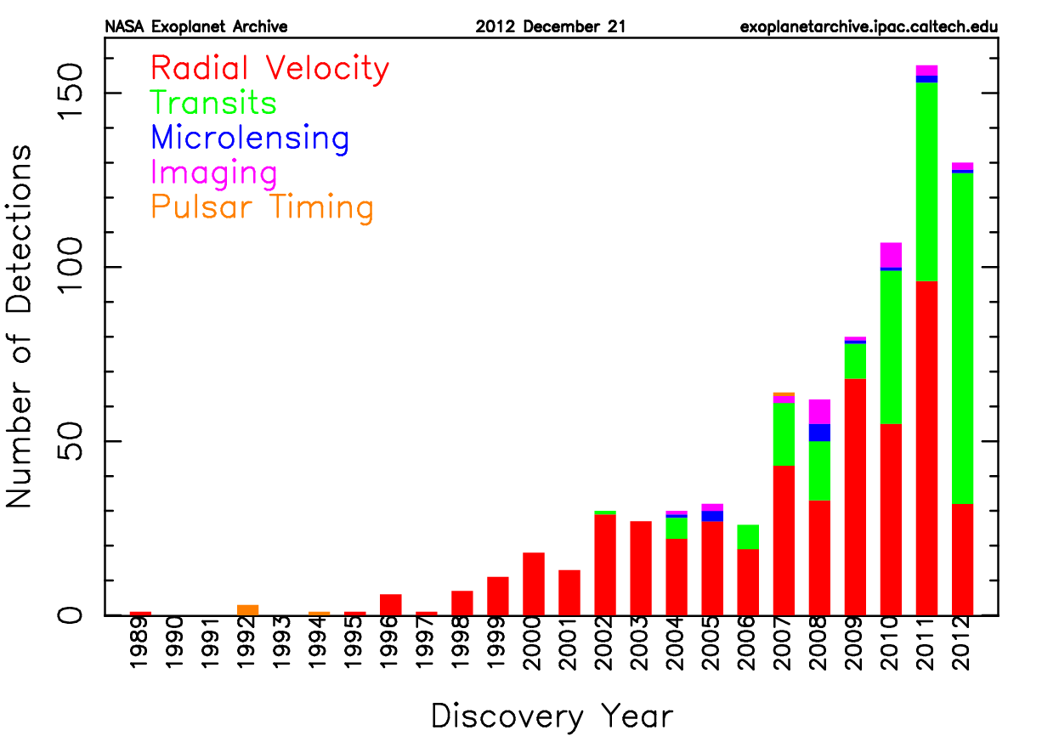
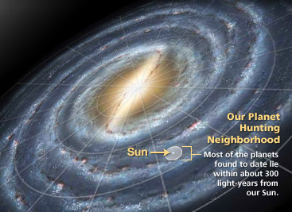
Current Exoplanet Statistics
817 Planets around 642 Stars
2320 Kepler Candidates
44 ‘Habitable’ Planets (incl. Earth)

Slide 5
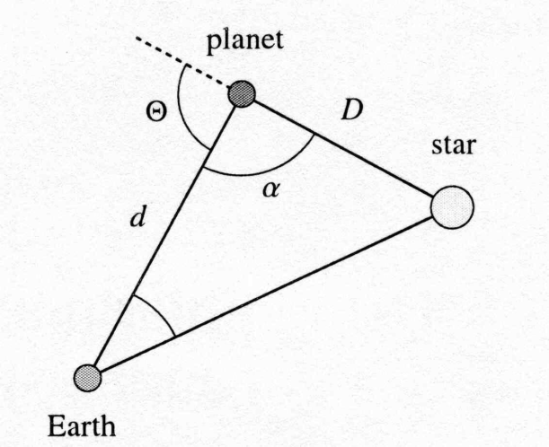
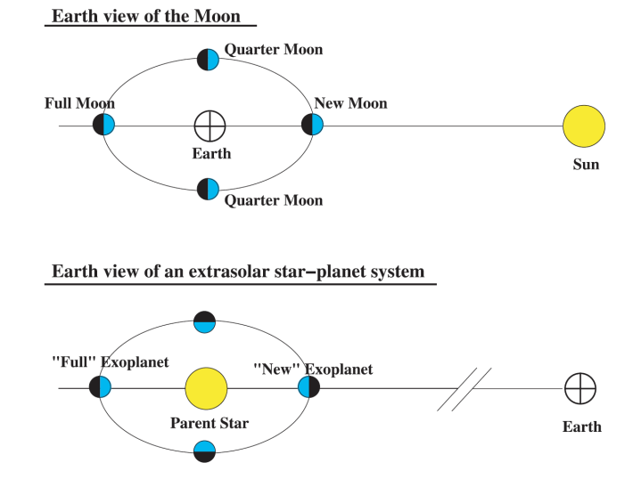
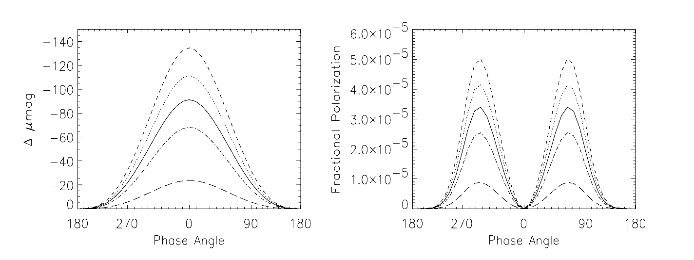
Optical Concepts
Planetary Light Scattering and Polarization
Linear Polarization Measurements
Can Detect Surface and
Atmosphere Properties
Spectropolarimetry Includes
More Information about
The Nature of the Source

Slide 6
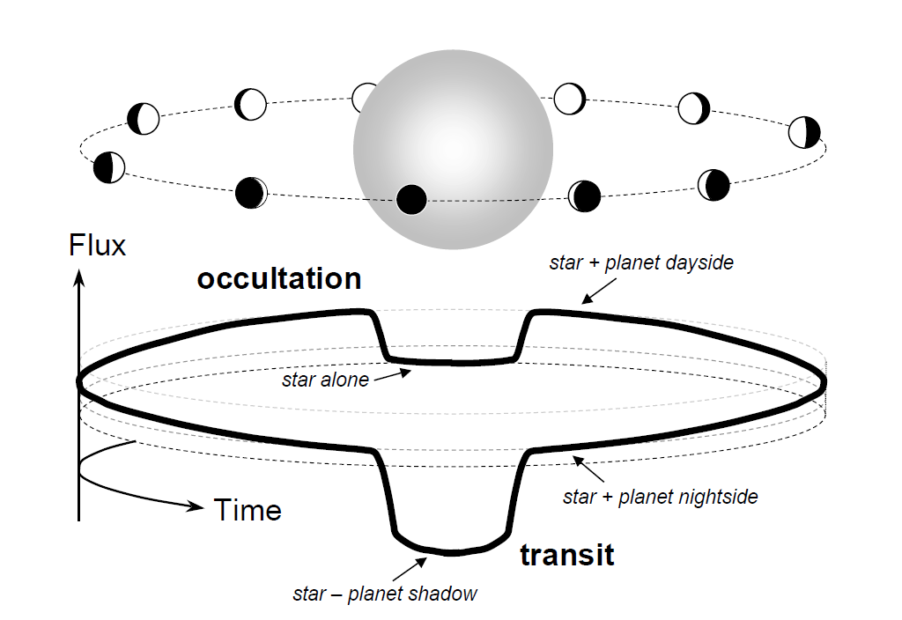
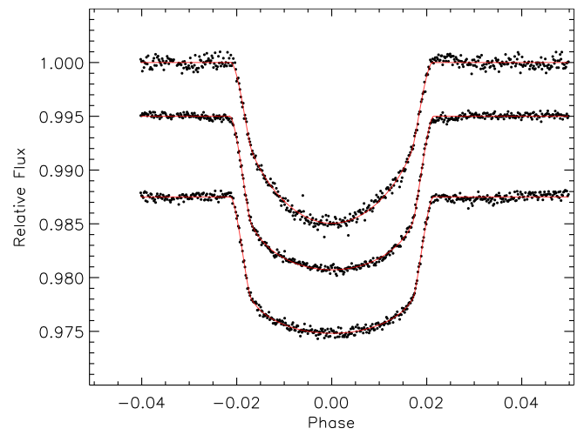
Transit Photometry
(and Spectropolarimetry)
Comprehensive Info on Planet, Atmosphere
Timing Can Detect Unseen Planets
Crossing Orbits Only

Slide 7
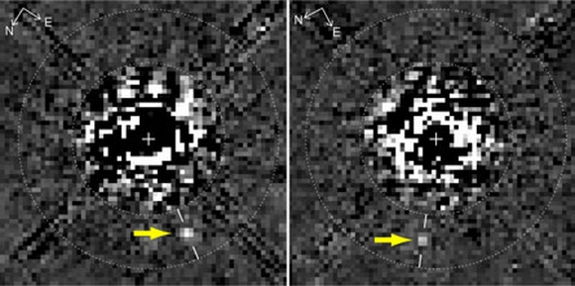
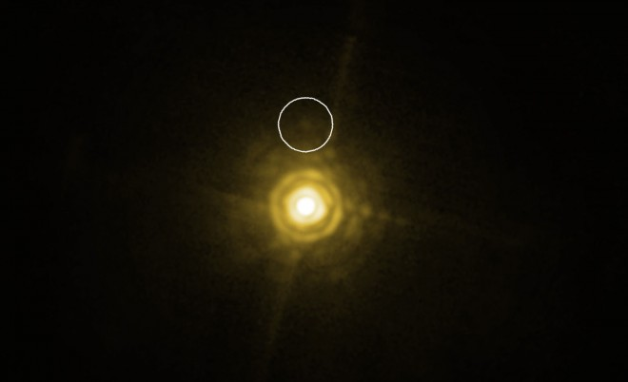
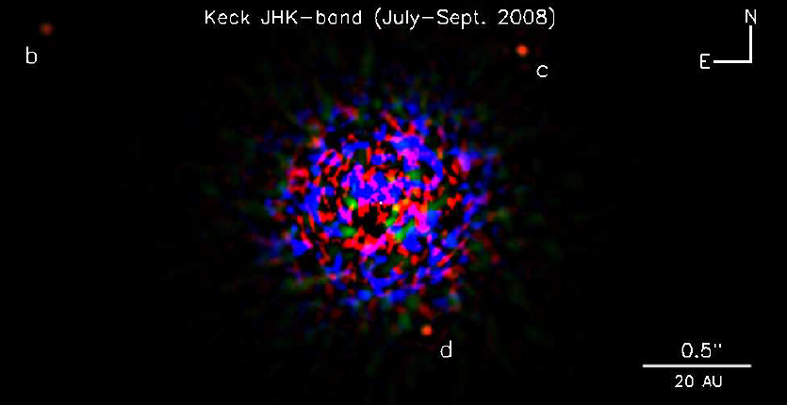
Direct Observation
AO and Clever Filters from Ground
Ideal for Space Based Telescopes
Expensive but Best Data
All Optical Techniques Possible

Slide 8
Looking for Life
( If the exoplanet is something like Earth)
Atmospheric Composition
Polarisation by Surface and Atmosphere
The ‘Red Edge’, Chlorophyll Analogues
Chirality

Slide 9
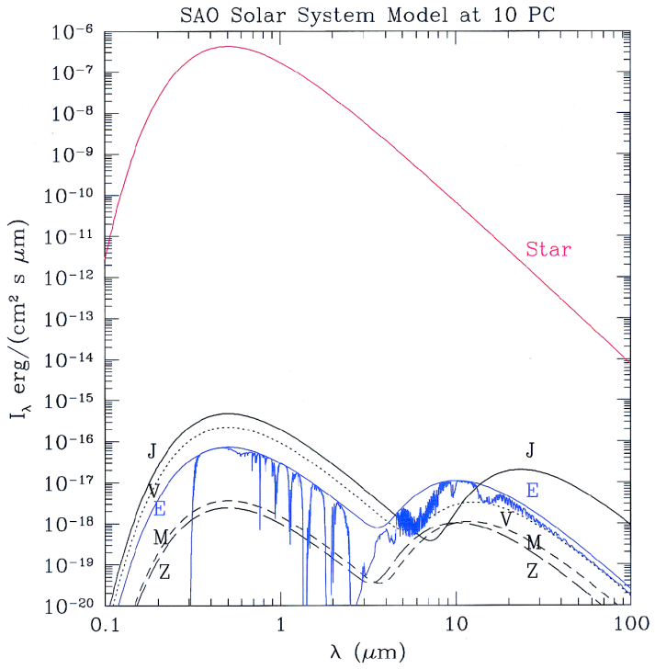
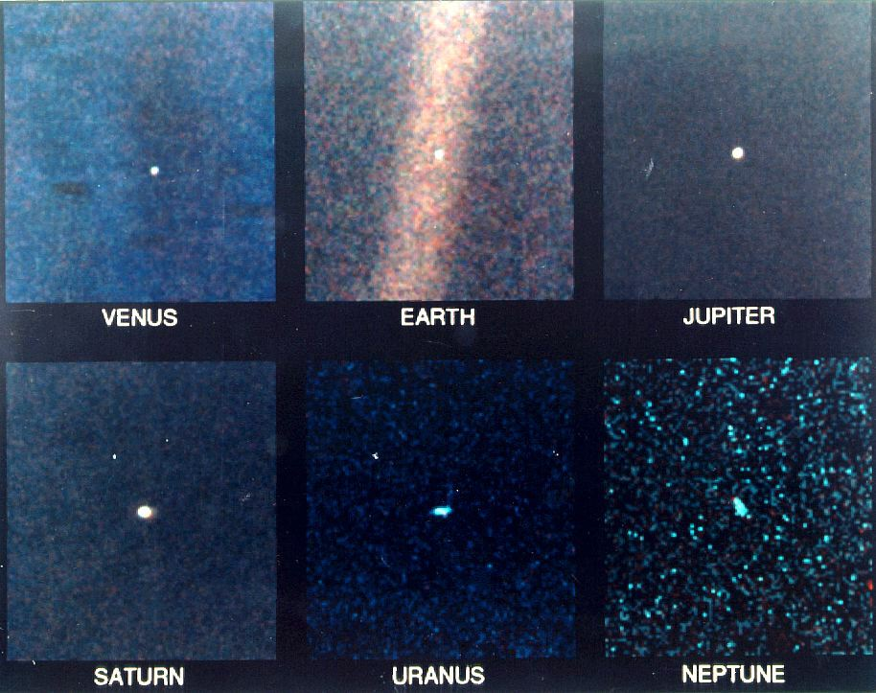
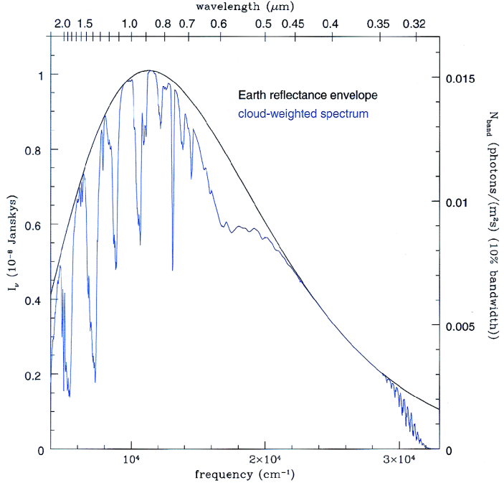
What Does Earth Look Like?
The Solar System from Voyager 1 [40.5 AU]
Atmospheric Absorption and Scattering
H₂O, O₂, CO₂ Visible, IR Absorption
IR Emission

Slide 10
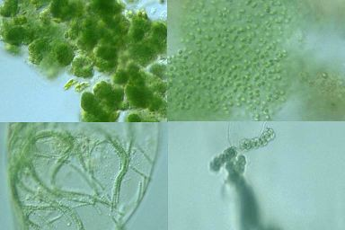
Earth Evolution and Biosignatures
The Presence of Free Oxygen is the
Strongest Signature of Life on Earth

Slide 11
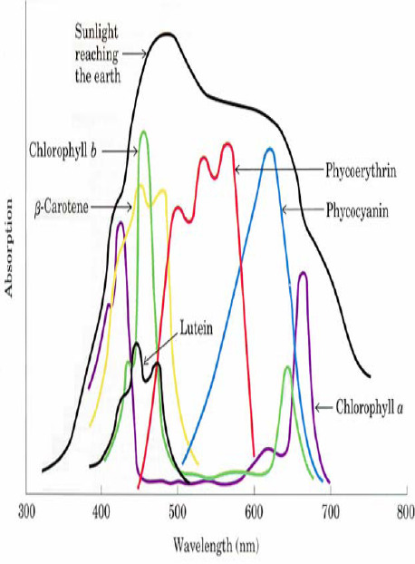
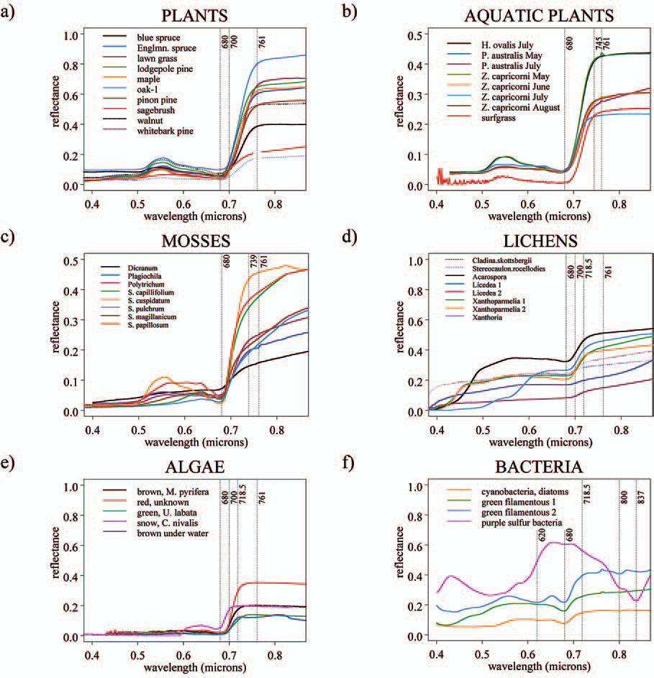
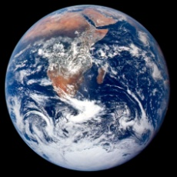
Chlorophyll and the Red Edge
Sharp Increase in Reflectivity
at ~680nm
Earth Imaging Diagnostic for
Vegetation, Algae, Crops

Slide 12
Chlorophyll and Chirality
(Homochirality Signatures)
Chlorophyll and many other complex organic molecules exhibit chirality
including amino acids, proteins, sugars
Earth Biochemistry is mostly left handed except for sugars
This means in part that the spectropolarimetric signatures for these
molecules will exhibit chiral characteristics in the absorption and scattering of light
Adds a possible additional dimension to the search for definitive life signatures
Evidence (several meteorites) exists that non-terrestrial amino acids
may also exhibit a left/right bias

Slide 13
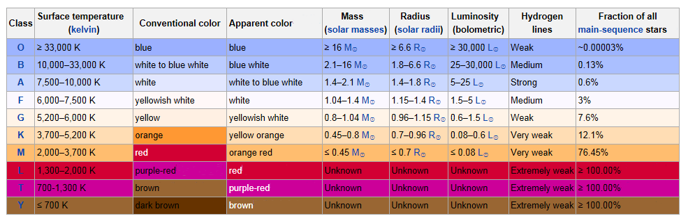
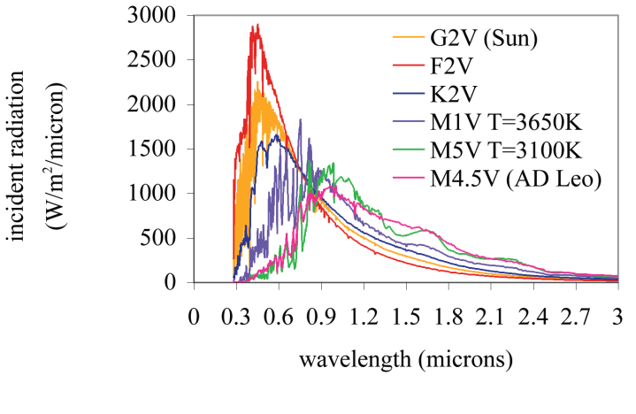
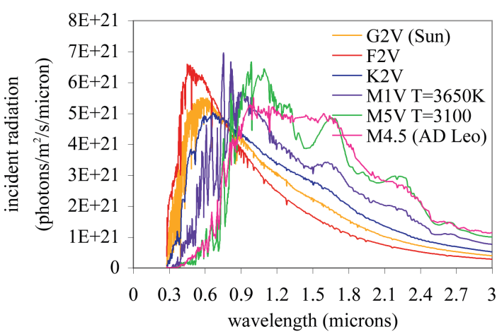
Exoplanet Signatures
Are Earth Biosignatures Relevant to Exoplanets?

Slide 14
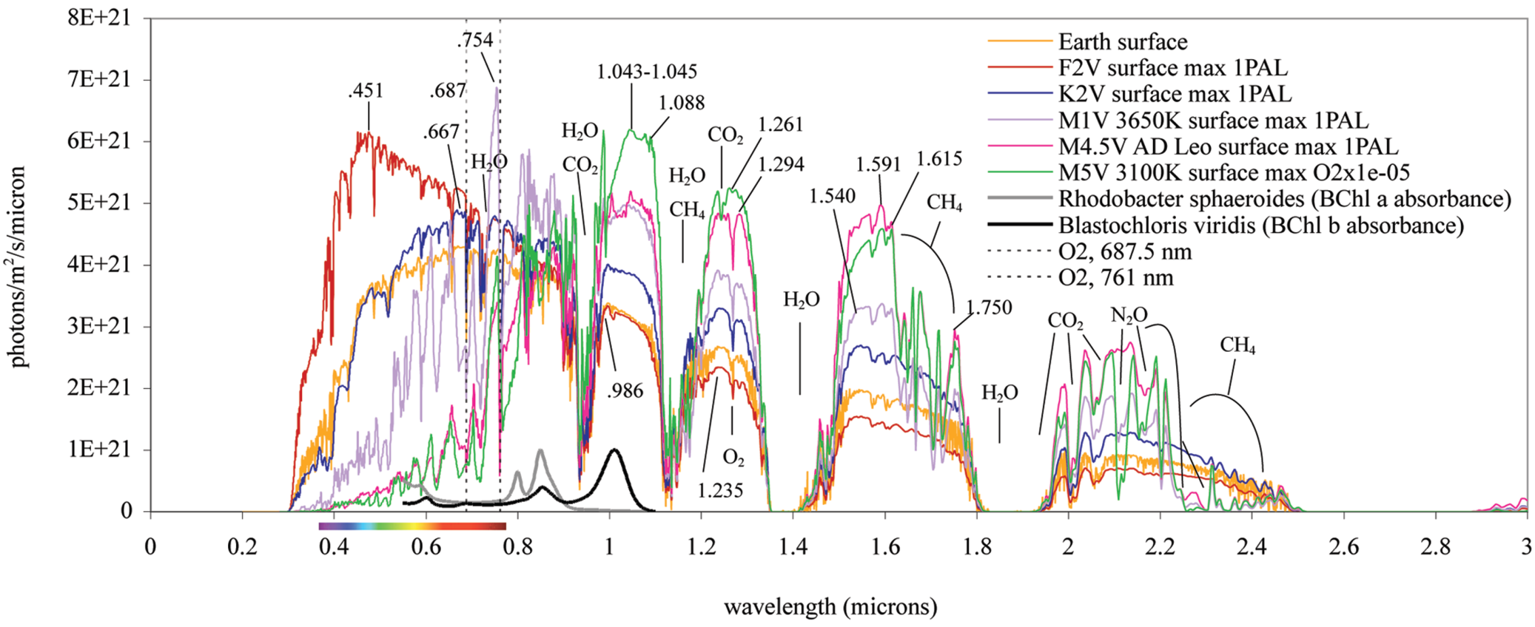
Modelling an Earth-Like Atmosphere With Different Star Types
(Kiang et al, 2007)

Slide 15
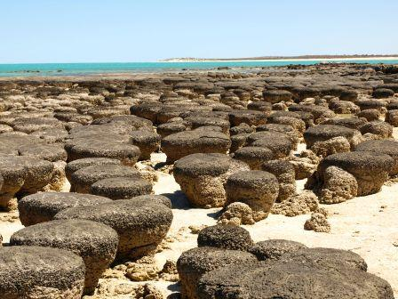
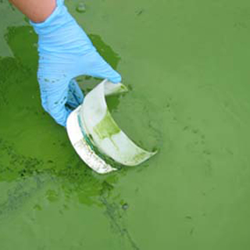
Assumptions
Earth-Like Planets in the ‘Habitable Zone’
Not too big, hot/cold
Free oxygen and water Indications
Non-Imaged but reflected/transmitted Light
separable from the star’s light
Most likely from detailed analysis of transits or direct observations
How many are there?...
Atmospheric Composition
Polarization by Surface and Atmosphere
  Scattering
The ‘Red Edge’, Chlorophyll Analogues
Chirality

Slide 16
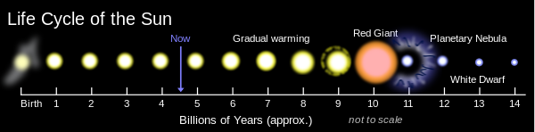
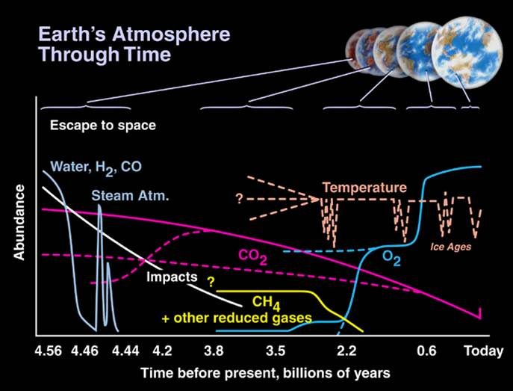
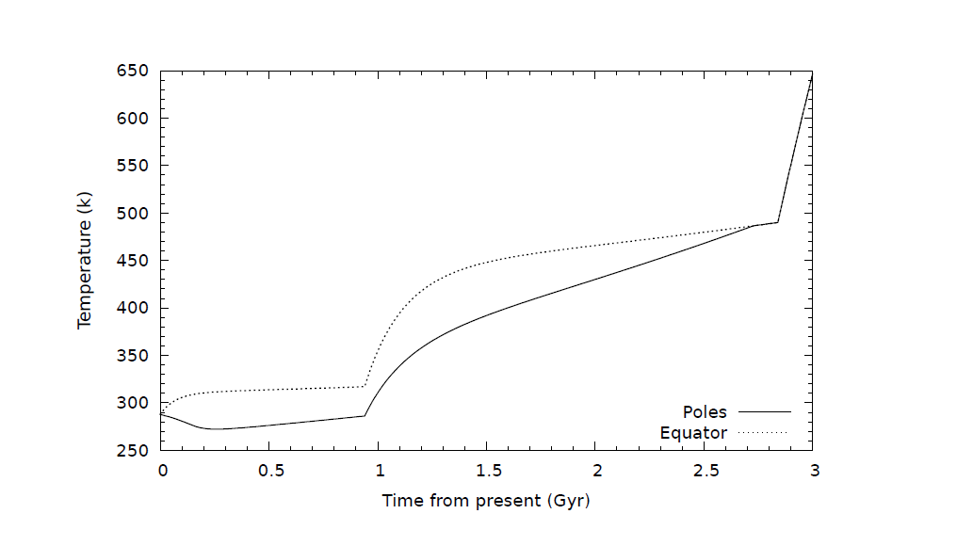
Time, The Other Dimension

Slide 17
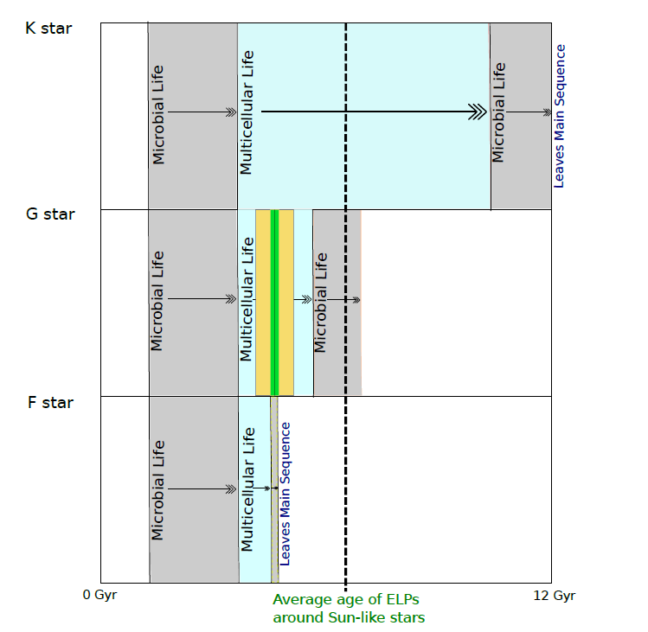
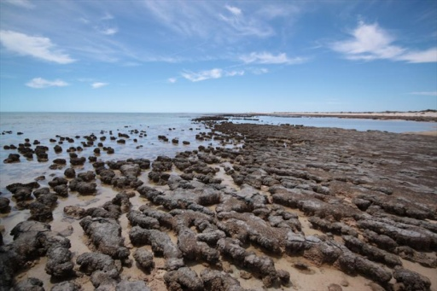
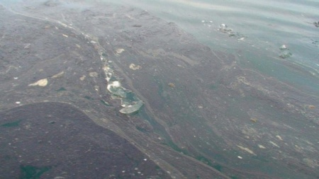
More About Time - Stellar Scales
After O’Malley-James & Cockell
Paleozoic/Mesozoic, Cenozoic, Homonids

Slide 18
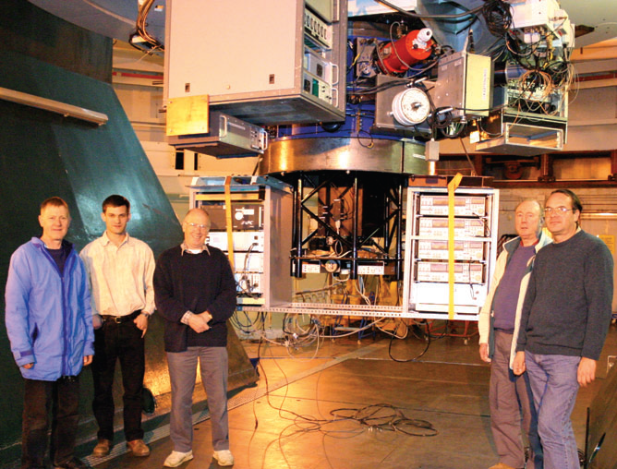
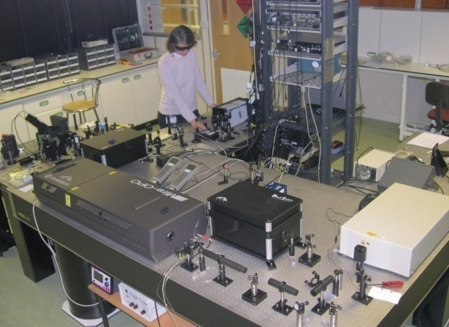
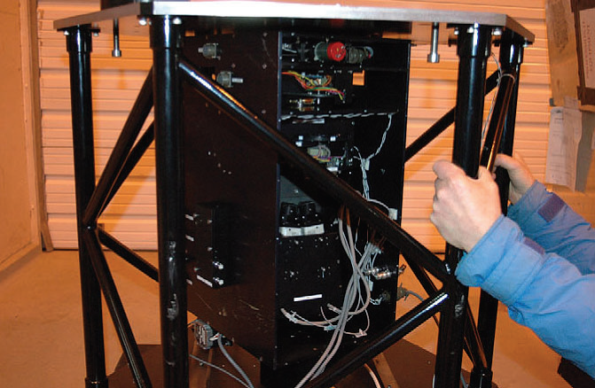
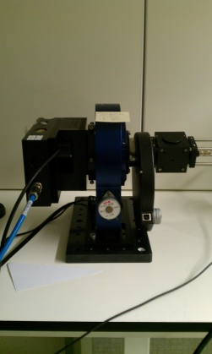
Astro-Polarimetry at UH
PlanetPol
Polarimetry Laboratory
Femtosecond Ti:Sa Laser/OPO
345-1360nm
PEM Stokes Polarimeters
Solar Polarimeters
Non Linear Optics, TCSPC
Organic and Inorganic , BG Algae

Slide 19
Biosignature Measurements Relevant to Exoplanets
UH Research Basis
Spectropolarimetry of Biological Materials
Stokes Polarimetry
Scattering Properties
Reflection and Transmission Spectra
Common, Generic, Visible from Space
Leaves
Algae, Plankton
(Lichens?)
(Inorganic False Positives?)

Slide 20
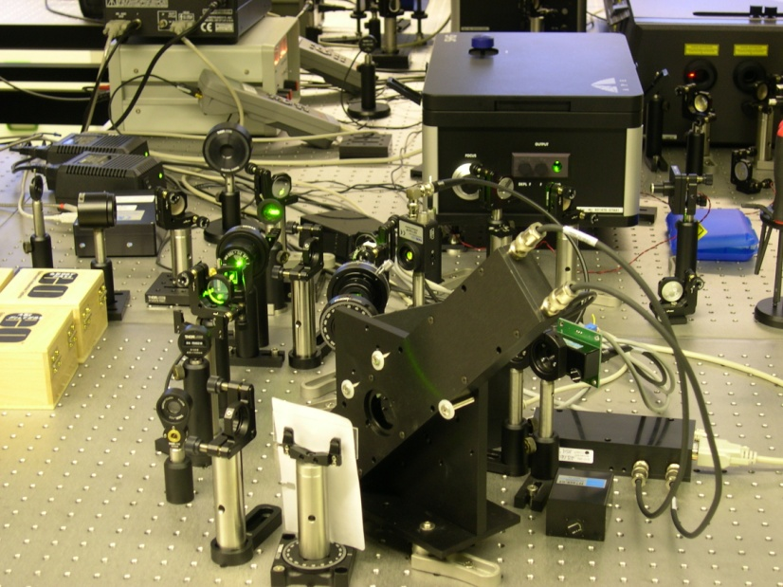
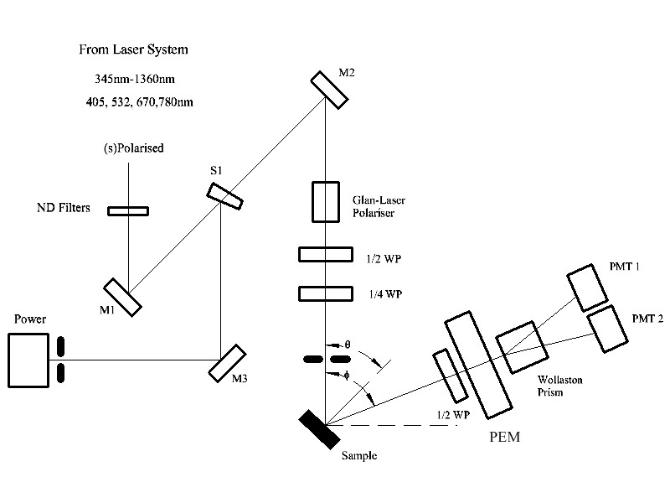
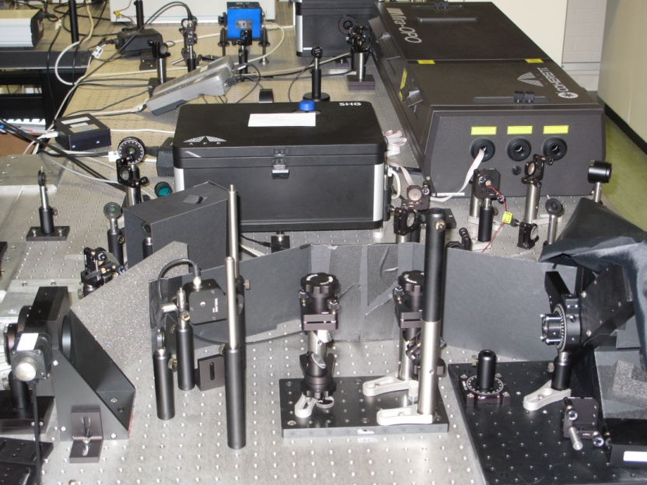
UH Stokes Spectropolarimeter

Slide 21
Spectropolarimetry of Plants and Lichens
‘Typical’ Leaves
Arabidopsis Thaliana
Quercus Robur
Ficus Benjamina
Others

Slide 22
Spectropolarimetry of Plants and Lichens
Lichen and Algae Samples
A Cyanobacteria (principally Gloeocapsa) biofilm on dolomite rock from the
polar desert, Devon Island, Canadian High Arctic
B Cyanobacteria (principally Lyngbya, Phormidium) biofilm on sandstone
from Beer, Devon, UK
C Cyanobacteria (Nostoc) Curled mat and sheets, Devon Island, Canadian High Arctic.
D Cyanobacteria (Lichen) biofilm growing on volcanic basalt from the Isle of Skye, Scotland.
CC0709-1- 8 -- Lichen from Iceland on basalt, various species.
Pipwell – Green biofilm on limestone from Northhamptonshire,
UK Tile – Roof tile with black cyanobacteria deposits from Hertfordshire, UK
GypArc – Biofilm deposits on gypsum from the Canadian high arctic.
Atacama - Biofilm on crumbly limestone from the Atacama desert, Chile.
1980 – Lichen on pumice from the 1980 lava flow of the volcano Mt. Hekla, Iceland.
1913 – Lichen on pumice from the 1913 lava flow of Mt. Hekla, Iceland.
Samples from C. Cockell

Slide 24
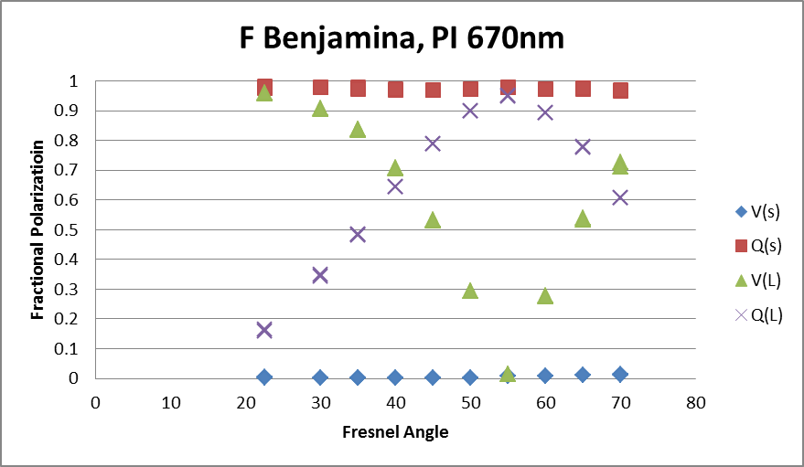
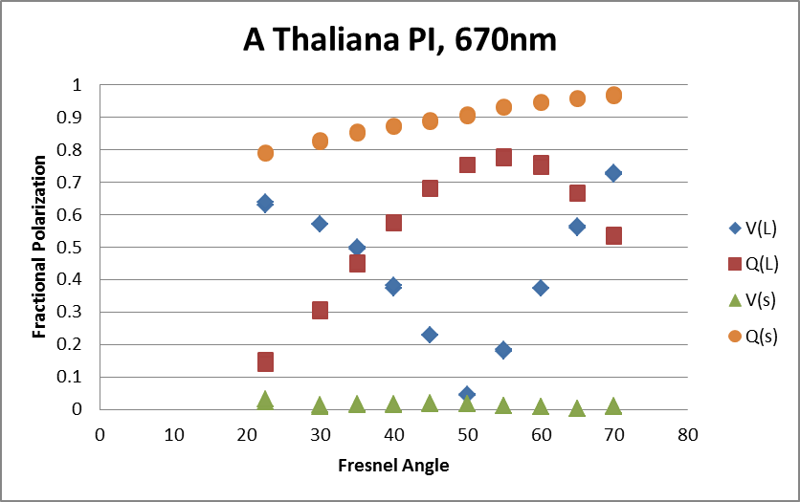
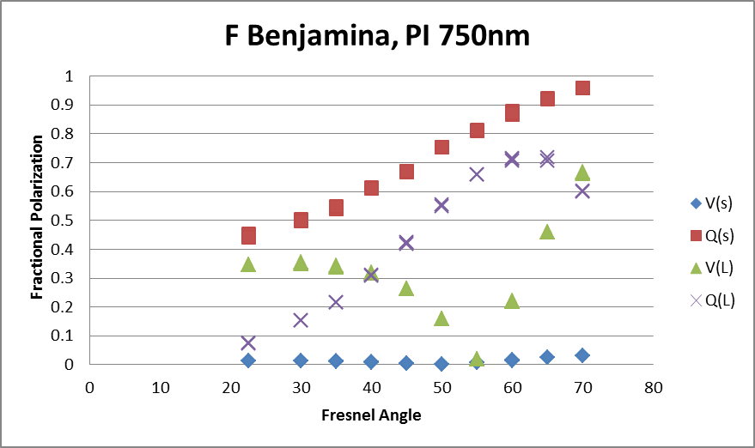
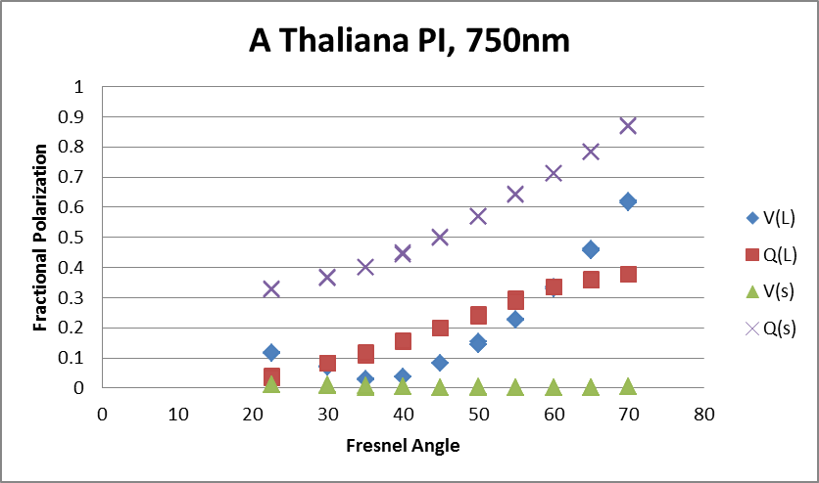
Leaves and Angular Variations

Slide 25
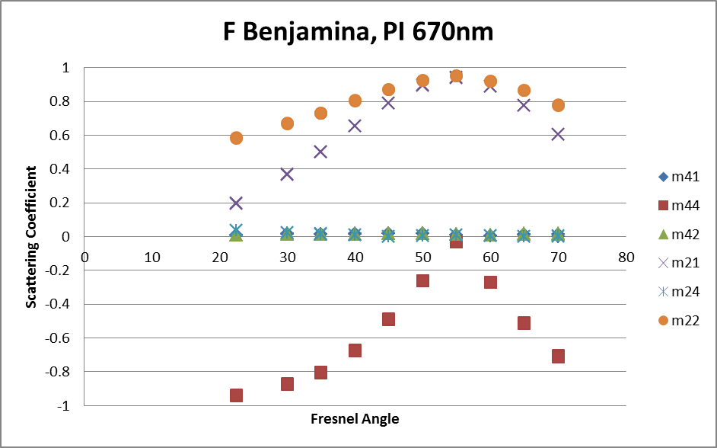
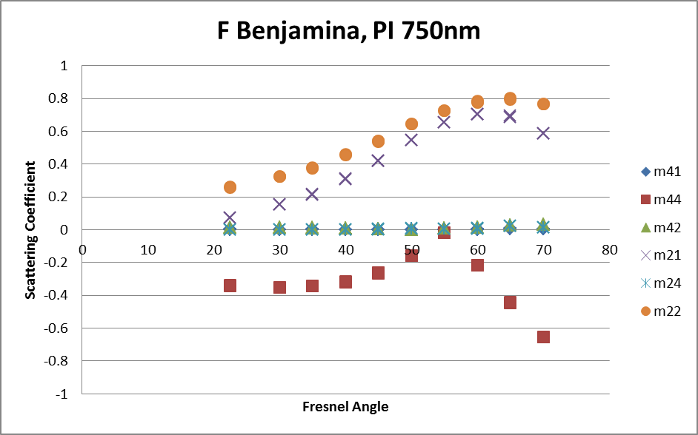
Stokes Coefficients and Chirality
Leaves are best described as relatively simple dielectric surfaces with varying linear absorption in the bulk material.
There are significant differences between polarized scattering measurements at wavelengths shorter or longer than the chlorophyll absorption edge.
The surface properties of the leaf dominate at shorter wavelengths. The polarized scattering is similar to a simple dielectric with a rough surface and n~1.4.
At longer wavelengths there appears to be deeper penetration and more multiple scattering resembling a rough, higher average refractive index material.
This combination conspires against detecting chirality using m41

Slide 26
Background Scattering
Typical Scattering from rocks and minerals

Slide 27
Spectropolarimetry of Plants and Lichens
Conclusions
If it’s Green There are Strong Signatures
Protective Pigmentation Masking is Significant in Lichens
Strong Linear Polarisation from Leaves – Simple Dielectrics
Linear Polarisation Changes at the Red Edge
Circular Polarisation Changes (Chirality) are Detectable
Substrate Signatures are Probably not Significant
Polarisation Signal Contrast Modelling Will be Needed
The very small values of the component m41 in almost all measurements means that identifying a chiral scattering process from leaf/chlorophyll analogues by remote sensing will be a challenging task.

Slide 28
Amino Acids in Silica – Detection of Chiral Scattering
Query: Can the rotary optical properties of right and left amino acids be detected in wet and/or dry mixtures of small grained silica (fine purified sand)?
0.25M solutions of six L and R forms of common Amino Acids and Glycine
mixed with equal volumes of silica, measured in the Stokes Polarimeter
at several wavelengths, dried, remeasured.
Glycine – not optically active
Alanine – d,l
Serine - d,l
Valine – d,l
Glutamic Acid – d,l
Aspartic Acid – d,l
Proline – d,l
Silica – dried, calcined ~100um

Slide 29
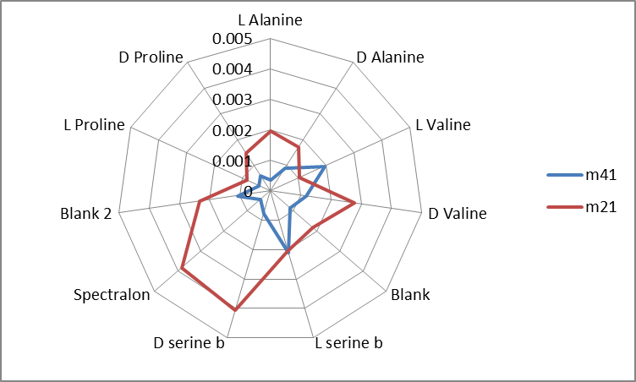
670nm, 850nm and dry measurements are not distinguishable from noise. Conclusion: Might be possible at ~300-350nm

Slide 30
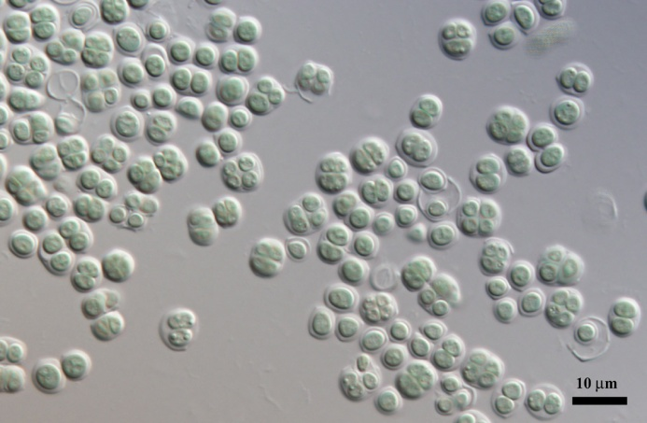
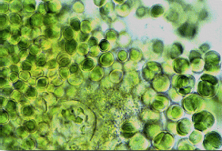
Spectropolarimetry of Blue-Green Algae
Chroococcidiopsis
Chroococcidiopsis is one of the most primitive cyanobacteria, blue-green algae, known. It is a photosynthetic, coccoidal bacteria and is known for its ability to survive harsh environmental conditions, including both high and low temperatures, ionizing radiation, and high salinity.
Wikipedia

Slide 31
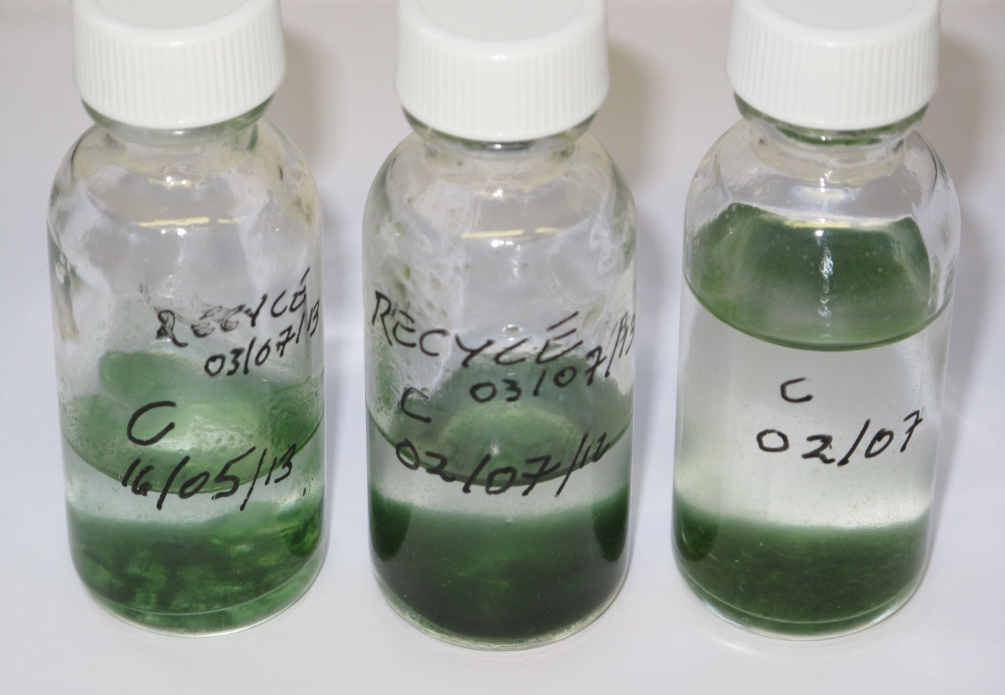
Grow Your Own
(with help from C Cockell)

Slide 32
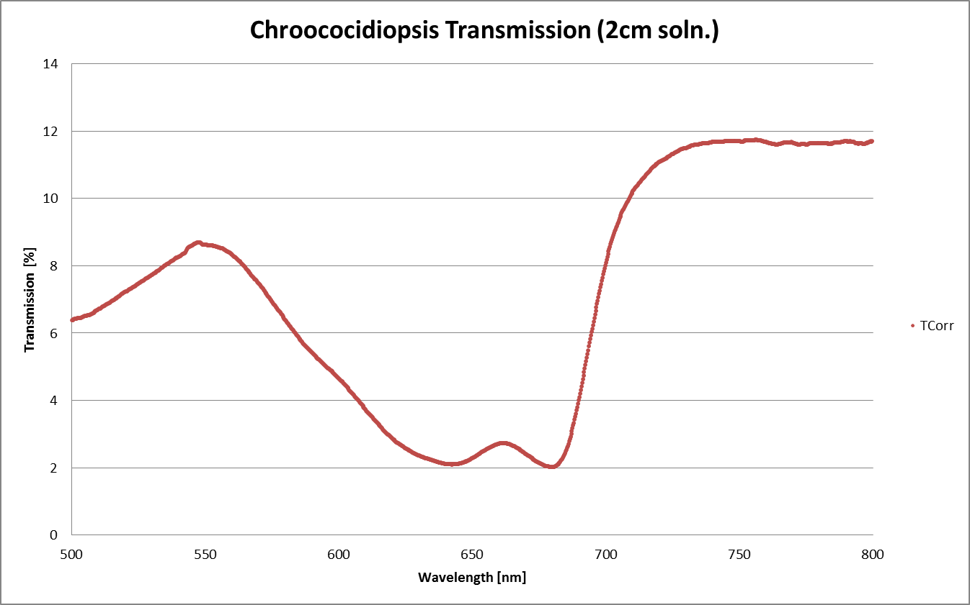
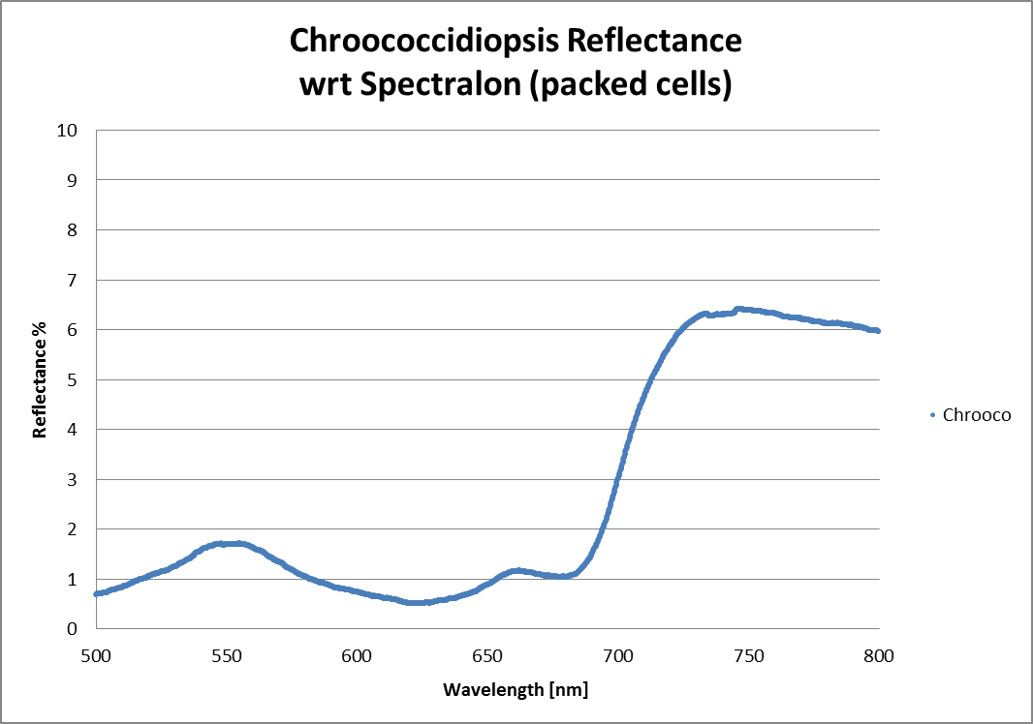
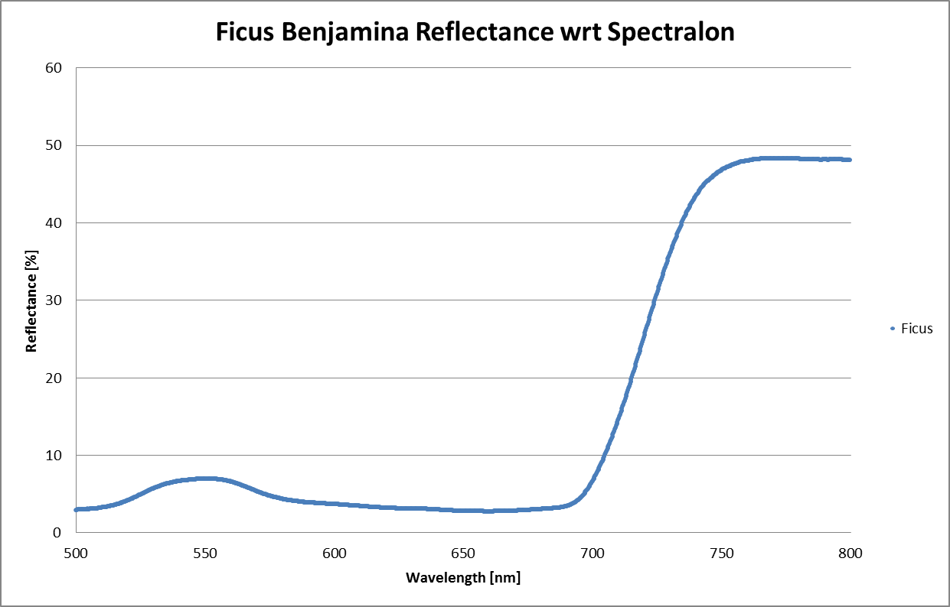
Spectropolarimetry of Blue-Green Algae
Chroococcidiopsis

Slide 33


Spectropolarimetry of Blue-Green Algae
Chroococcidiopsis
Chrooco. Has similar characteristics to leaves except near 700nm where m44 becomes very small. Repeat measurements confirm this behaviour…

Slide 34


Slide 35
Summary and Conclusions
If it’s Green there are strong spectroscopic and polarisation signatures
  If protective pigments are present, signatures are weak
Strong linear polarisation signatures from leaves near the Red Edge, weak circular polarisation signatures
Results for Chroococcidiopsis are similar* but there are very interesting circular scattering properties to be investigated …
Circular polarization (chirality from m41) is detectable…just, with current techniques
False positives from surface minerals are probably not significant
Detecting amino acids directly may be possible at short wavelengths
Real data from Earth Observations is sparse
Modelling of polarisation signal contrast is needed for remote sensing
Spectroscopy will be the main method for initial detection
Polarimetry will add further details about the nature of the life
*And are consistent with previous data on Rhodospirillum rubrum
Sparks, et al
Charles Cockell and his Group at Edinburgh Univ. are gratefully acknowledged for their help in culturing the Chroococcidiopsis material

Slide 36
References
http://www.markelowitz.com/Exoplanets.html
Joshua N Winn, Earth and Planetary Astrophysics,arXiv:1001.2010v4
S. Seager, arXiv:astro-ph/0503302v1, Earthshine observations from Apache Point Observatory.
S. Seager et al,Vegetation’s Red Edge: A Possible Spectroscopic Biosignature of Extraterrestrial Plants, http://lanl.arxiv.org/abs/astro-ph/0503302v1
O'Malley-James et al. Swansong Biospheres,arXiv:1210.5721v1
NANCY Y. KIANG et al,ASTROBIOLOGY Volume 7, Number 1, 2007 DOI: 10.1089/ast.2006.0105, DOI: 10.1089/ast.2006.0108
Heinrich D. Holland Phil. Trans. R. Soc. B (2006) 361, 903–915 doi:10.1098/rstb.2006.1838
S. SEAGER PHOTOMETRIC LIGHT CURVES AND POLARIZATION OF CLOSE-IN EXTRASOLAR GIANT PLANETS THE ASTROPHYSICAL JOURNAL, 540:504-520, 2000 September 1
DAVID J. DES MARAIS et al,Remote Sensing of Planetary Properties and Biosignatures on Extrasolar Terrestrial Planets, ASTROBIOLOGY
Volume 2, Number 2, 2002
C.S. Cockell et al,Darwin—A Mission to Detect and Search for Life on Extrasolar Planets,ASTROBIOLOGY,Volume 9, Number 1, 2009,DOI: 10.1089/ast.2007.0227
Michael F. Sterzik et al,Biosignatures as revealed by spectropolarimetry of Earthshine, Nature,1 MARCH 2012 | VOL 483 | NATURE
J. Hough, et al,The polarization signature of extra-solar planets, doi:10.1017/S1743921306000913
Pilar Montanes-Rodriguez, VEGETATION SIGNATURE IN THE OBSERVED GLOBALLY INTEGRATED SPECTRUM OF EARTH
CONSIDERING SIMULTANEOUS CLOUD DATA: APPLICATIONS FOR EXTRASOLAR PLANETS, The Astrophysical Journal, 651:544Y552, 2006 November 1
J. Hough etal, PlanetPol: A High Sensitivity Polarimetre for the Direct Detection and Characterisation of Scattered Light from
Extra-solar Planets,THE ING NEWSLETTER No. 9, March 2005
https://astrobiology.nasa.gov/articles/2012/07/25/how-life-turned-left/
https://astrobiology.nasa.gov/articles/2012/08/09/an-excess-of-enantiomers-in-primitive-meteorites/
W.E.Martin et al,Polarized Optical Scattering Signatures from Biological Materials,Journal of Quantitative Spectroscopy & RadiativeTransfer, doi:10.1016/j.jqsrt.2010.07.001
W.B. Sparks et al, Circular polarization in scattered light as a possible biomarker, Journal of Quantitative Spectroscopy & Radiative Transfer 110 (2009) 1771–1779

Slide 37




Where’s This?

Slide 38


